Slide 1
Seismic Reflection imaging
Key learning outcomes of Lectures 1,2 and 3
Dr. Rebecca Bell

Slide 2
Learning outcomes lecture 1
You should now be able to…
Appreciate why seismic reflection data is important/useful
Understand the fundamental method (we will learn more about this later…)
Understand that seismic traces are the result of convolution between the
reflectivity series and a source wavelet

Slide 3
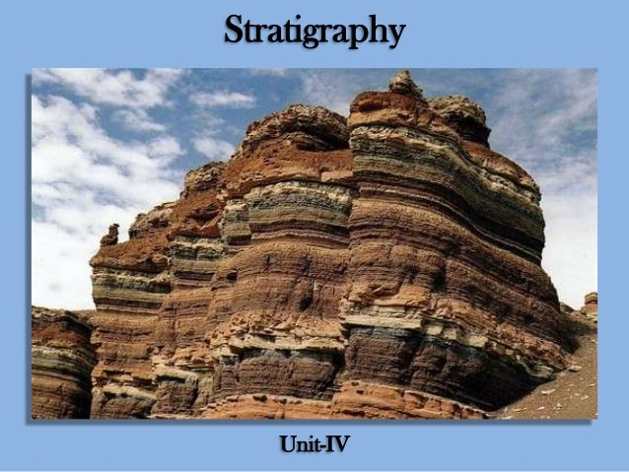
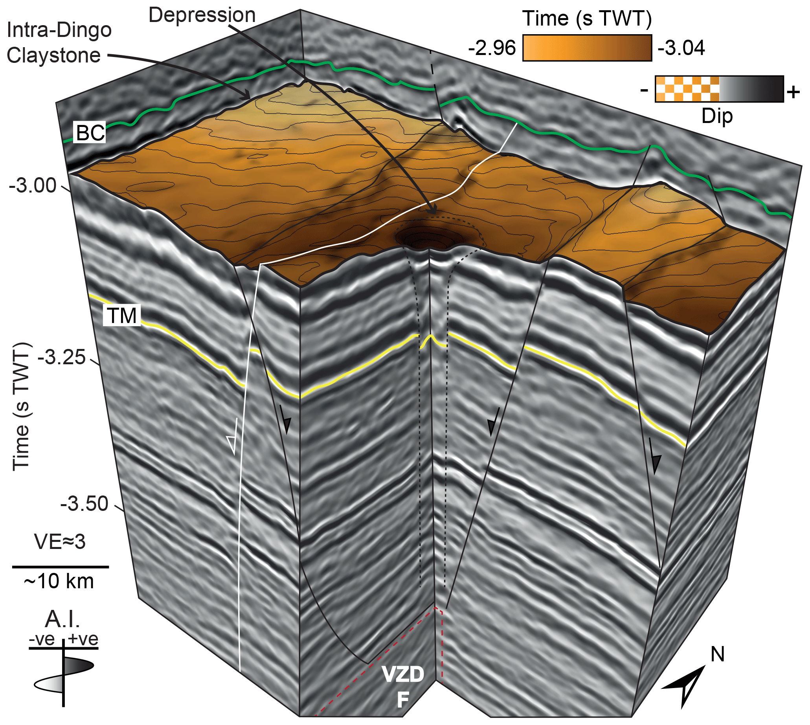
Appreciate why seismic reflection data is important/useful
Seismic reflection data allows us to image geological layers (stratigraphy) buried below the ground. It is a remote,
Non-destructive method (unlike drilling). The image below on the left shows a sedimentary rock outcrop containing
a fault in the middle and the image on the right shows sedimentary rocks and faults at a depth of around 4 km.
https://www.slideshare.net/gauravhtandon1/stratigraphy
Magee and Jackson, 2020, Solid Earth

Slide 4
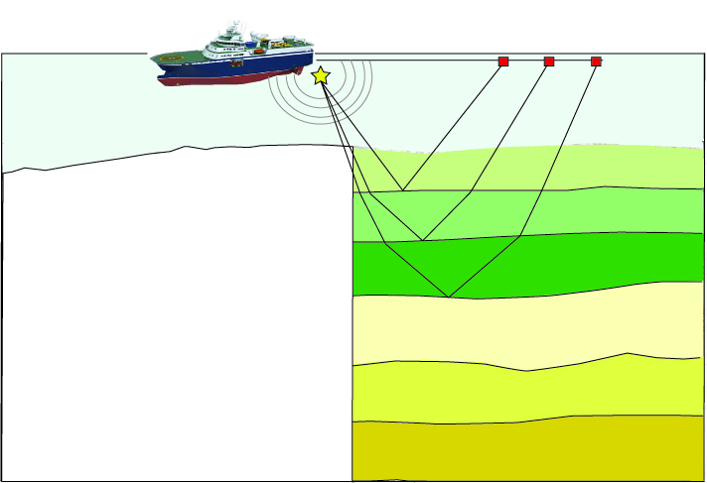
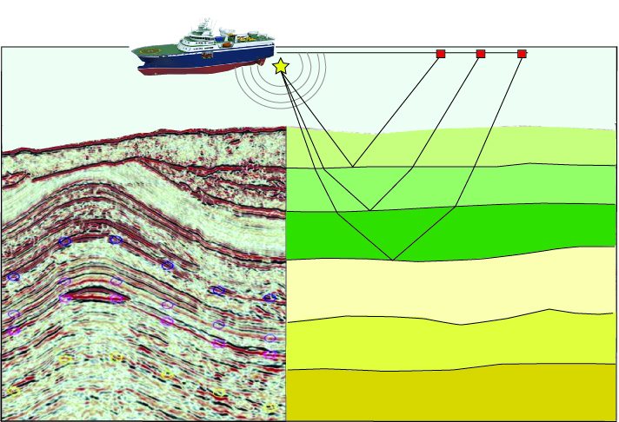
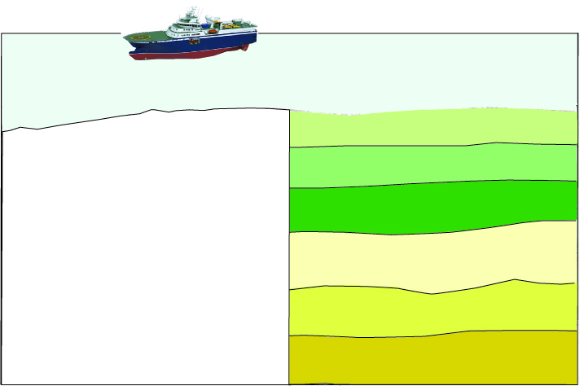
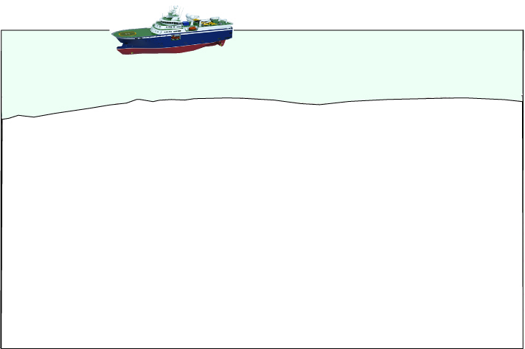
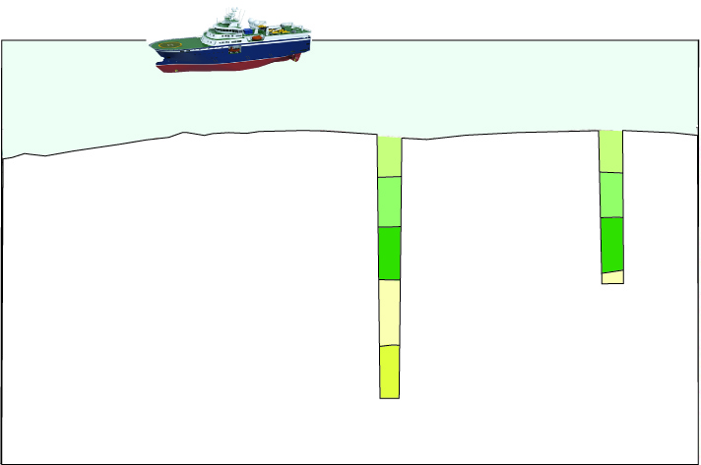
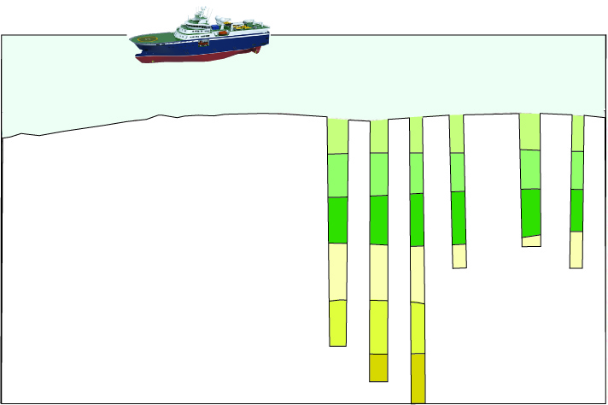
Understand the fundamental method
Time
Seismic data from the Baram Basin, NW Borneo (http://geoseismic-seasia.blogspot.it)

Slide 5
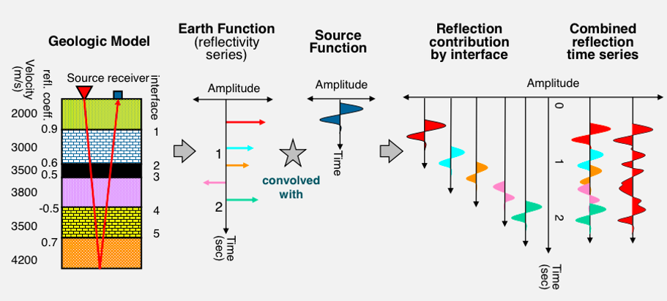
The convolution model of the Earth
Yanghua Wang, pers comm

Slide 6
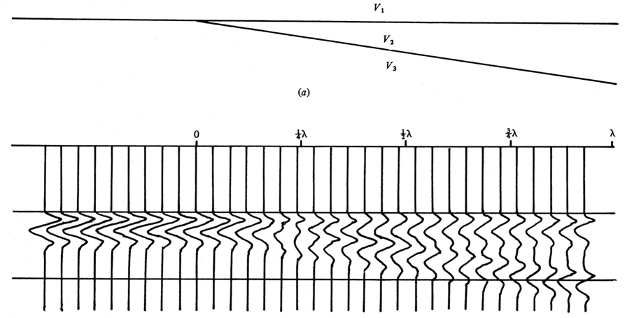
Understand that seismic traces are the result of convolution between the reflectivity series and a source wavelet
Input
pulse
+
v₃ > v₂ > v₁
+
Sheriff & Geldart, 1995
For a wavelet with a particular dominant frequency you can calculate the vertical resolution limit. Use
V=fl to calculate the wavelength then divide by 4 (the Rayleigh criterion)
Long wavelength wavelets = low resolution (thin geological features note resolved)
Short wavelength wavelets = high resolution (thin geological features resolved)

Slide 7
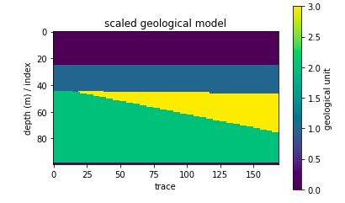
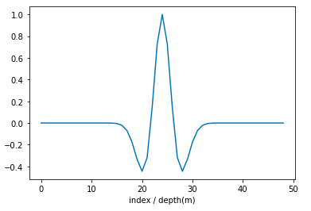
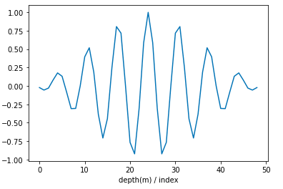
Resolution and wavelets….
Exercise 1
What would this geological feature look like in seismic data if we collected data with the wavelets below??
A simple wavelet
-Ricker wavelet
A complex wavelet
-Ormsby wavelet

Slide 8
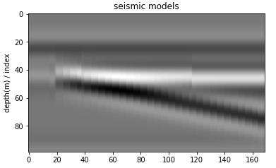
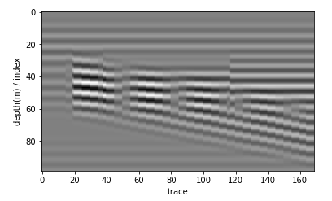
Resolution and wavelets….
Ideally, our wavelet will be as close as possible to a spike……complex wavelets lead to complex seismic data…
High resolution

Slide 9
Learning outcomes lecture 2
By the end of this lecture your should:
Understand why we need to use common depth point profiling methods to collect high-quality seismic data
2) Appreciate what sources are available and in what situation you would use different types of source

Slide 10
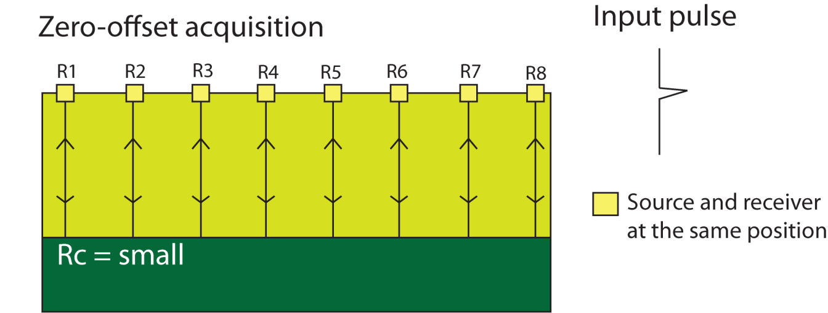
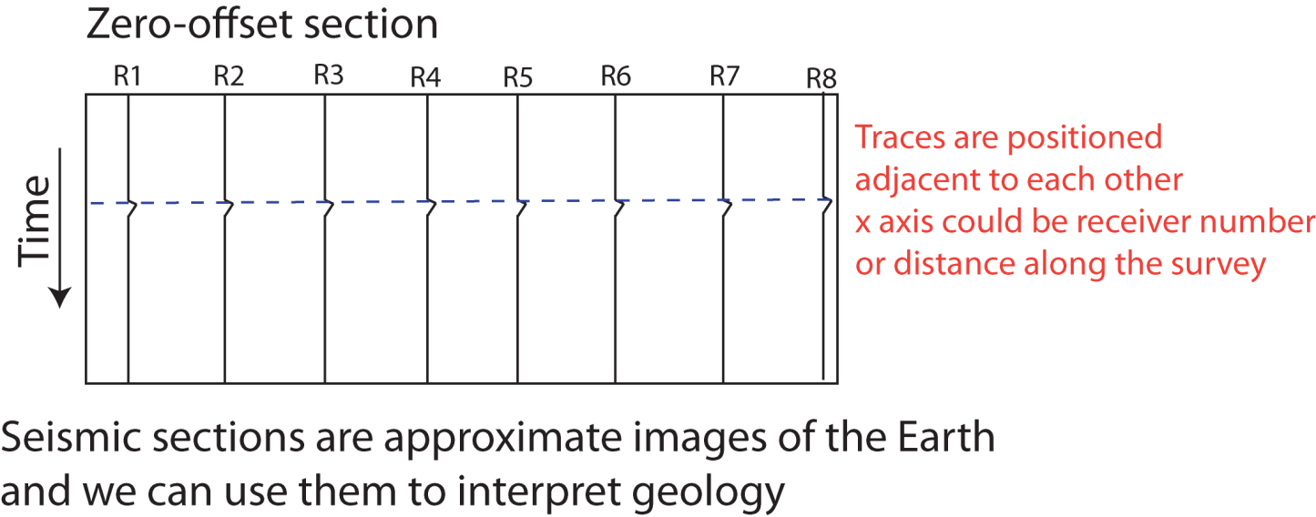
Zero-offset survey
The easiest way to create a SEISMIC SECTION is to conduct a zero-offset survey:
Rc = +’ve
Shot
Record
The problem is, reflection coefficients are very small, so the reflections have low amplitude

Slide 11
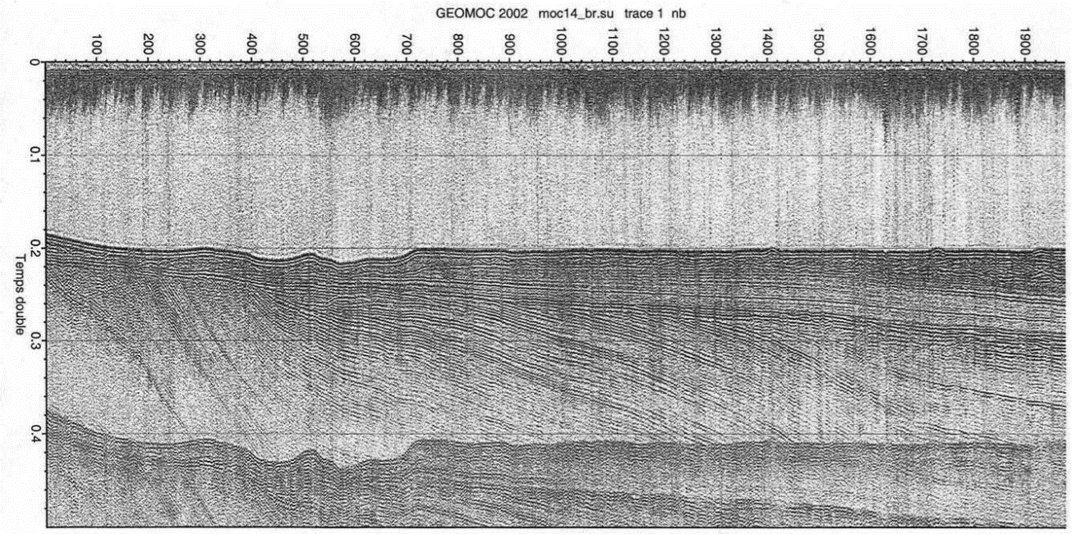
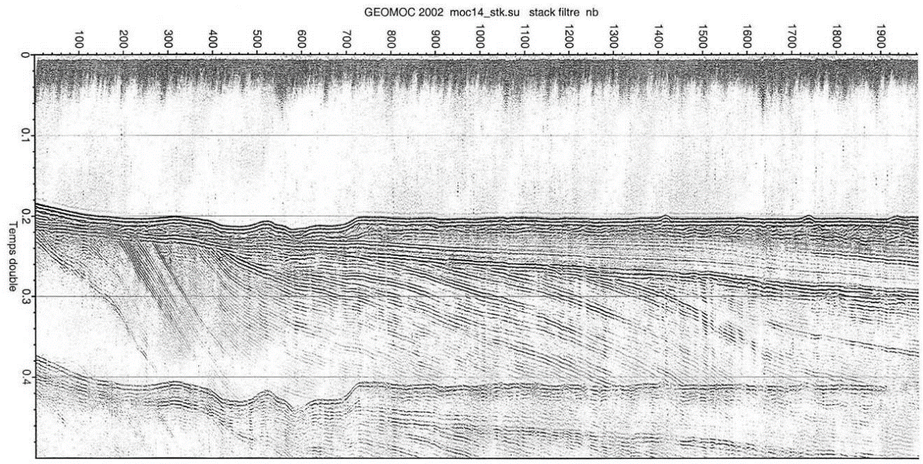
Zero-offset survey
The easiest way to create a SEISMIC SECTION is to conduct a zero-offset survey:
Rc = +’ve
Shot
Record
The problem is, reflection coefficients are very small, so the reflections have low amplitude

Slide 12
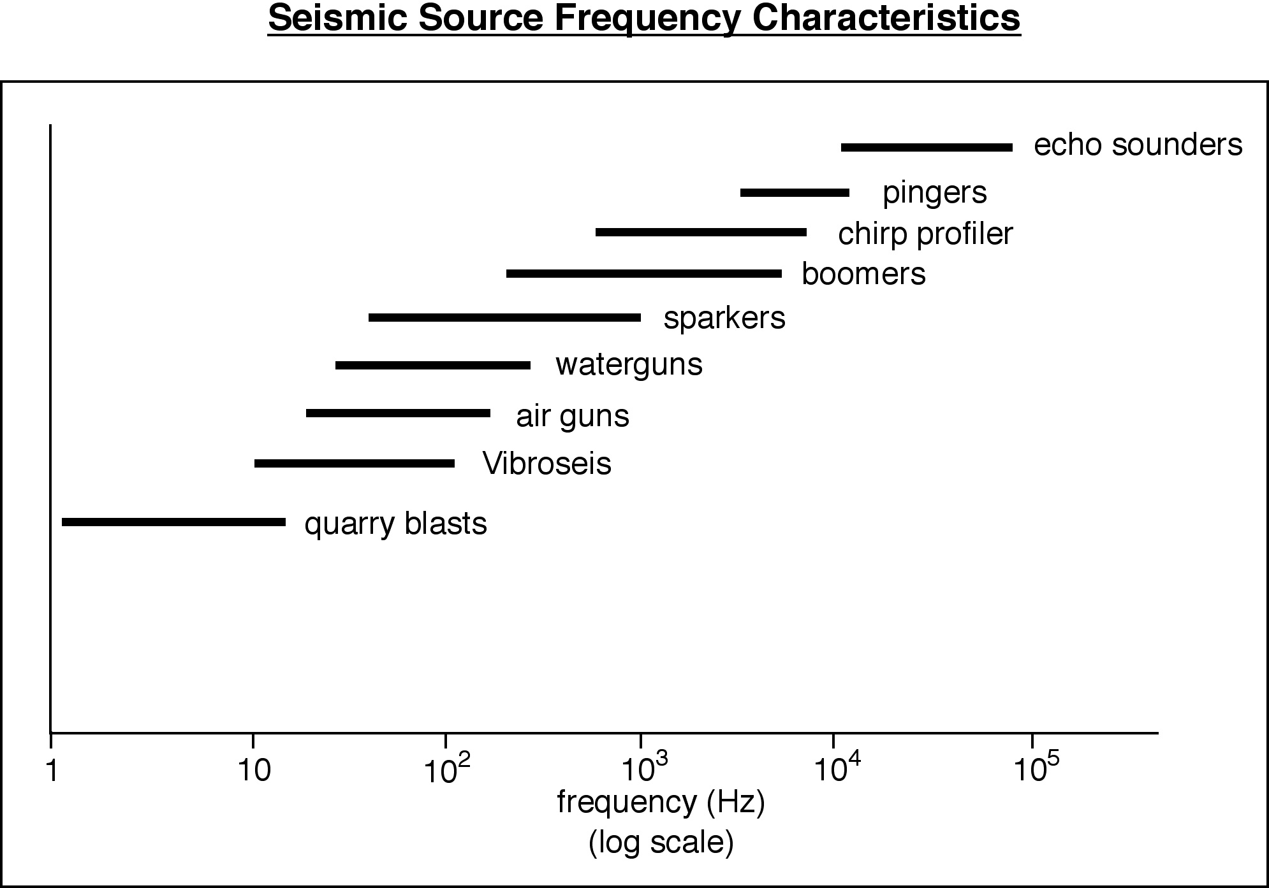
Seismic Sources
Shallow targets
(e.g. wind-farm installation, debris detection)
Crustal scale targets
(CO2 storage, geothermal)
MARINE
Consider the depth to your target of interest
and the resolution you need
LAND
Kearey, Brooks & Hill.
An introduction to
Geophysical Exploration

Slide 13
Learning outcomes lecture 3
By the end of this lecture you should:
Understand the difference between Shot gathers, CMP gathers and stacked seismic sections
2) Appreciate the importance of velocity analysis and NMO corrections as a fundamental step in seismic reflection data processing
3) Appreciate that it is important to know whether the data you download has been migrated, and whether it is post- or pre-stack migrated and time- or depth-migrated

Slide 14
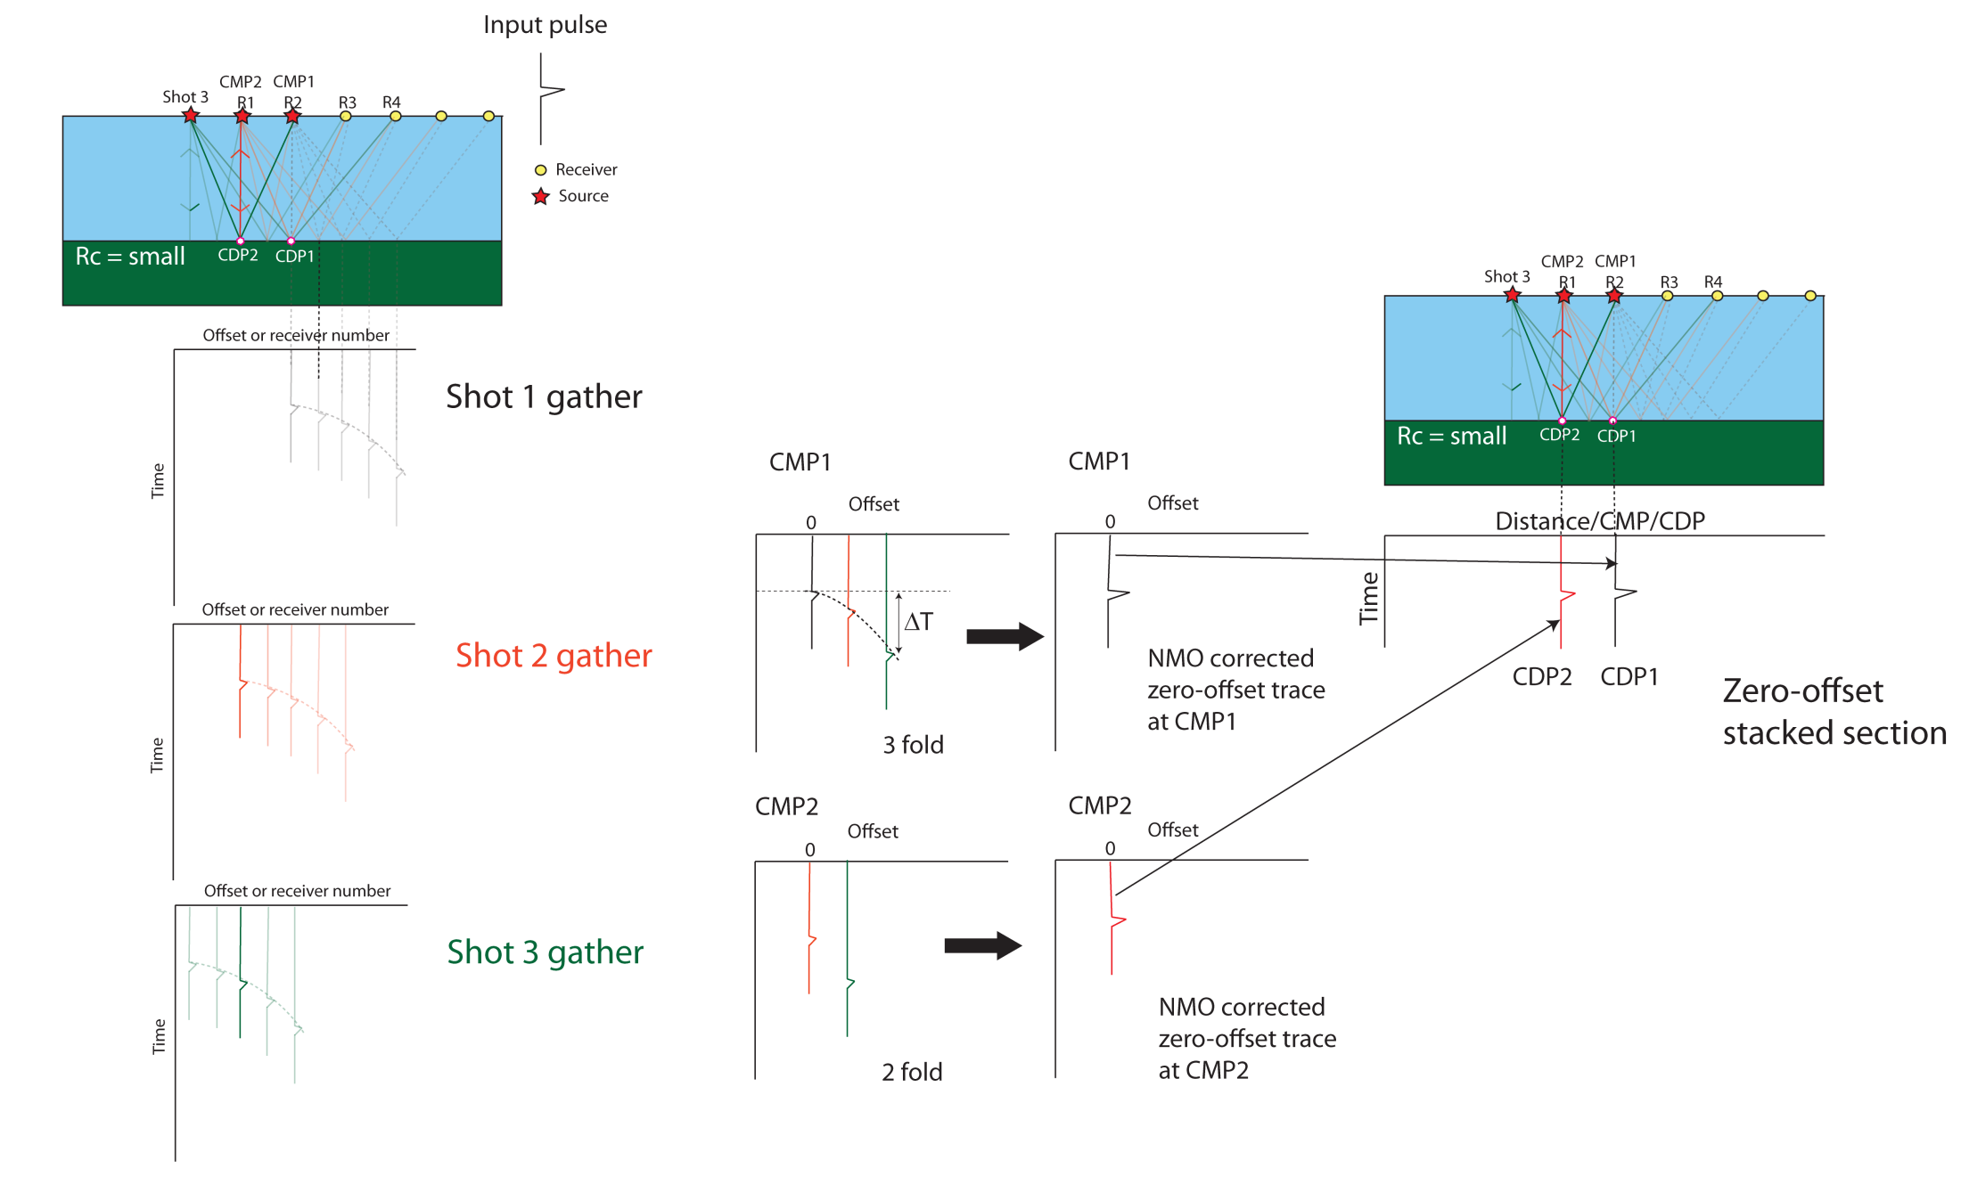
Shot gathers, CMP gathers and seismic sections

Slide 15
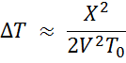
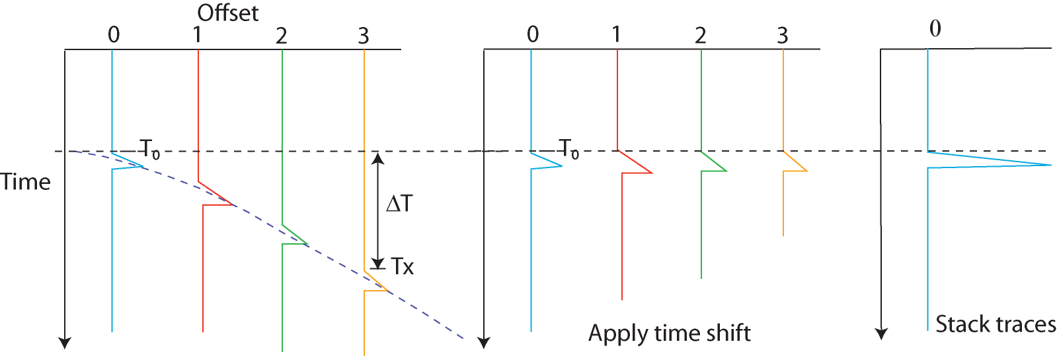
Normal Move-Out
This is the equation of a hyperbola, whose shape is controlled by V.
For the NMO, we want to apply a static time shift that approximates:

Slide 16
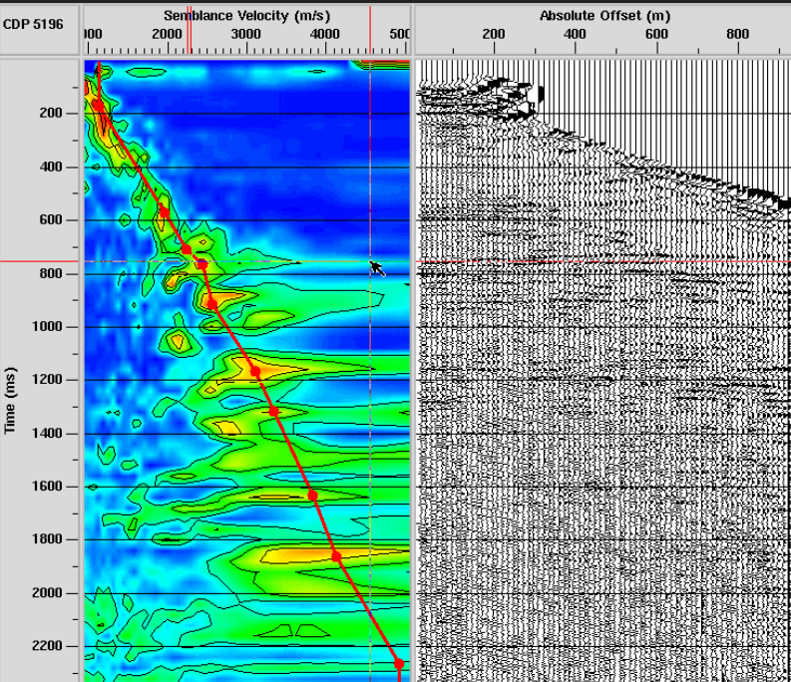
Semblance analysis
To determine the correct NMO velocities to use
for the whole CMP gather we do what is called
A semblance analysis.
This involves doing an NMO correction for a wide
Range of velocities (from velocities we know are
Too slow for the rock types to velocities we know are
Too high) and stack the traces.
We quantify how well the traces have stacked. In
Exercise 2 we do that by finding the amplitude of the
Stacked trace.
We then produce a diagram of depth vs velocity with
The value of the amplitude of the stacked trace. On
The right, red = high amplitude stacked traces, blue=
Low.
To find the right velocity we draw a line through the red
Areas which show best NMO correction.

Slide 17
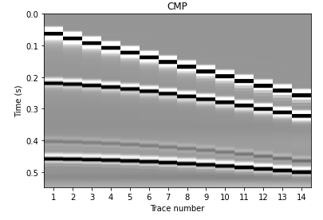
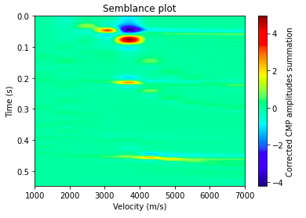
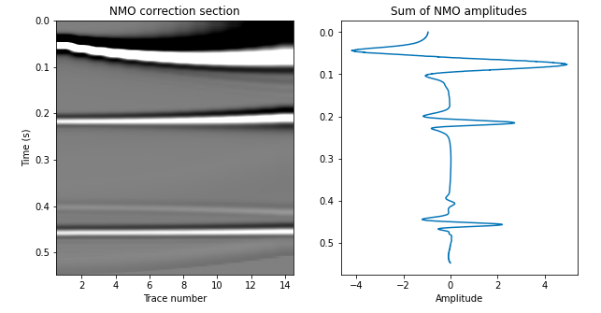
Semblance analysis- exercise 2
Only get stacked traces
at the depths we have
reflections (in real processing
we remove the direct
arrivals)
If we pick the right
NMO velocity the
reflections should
go horizontal when
we correct for ΔT
We then add
The traces
together to get
the stacked trace

Slide 18
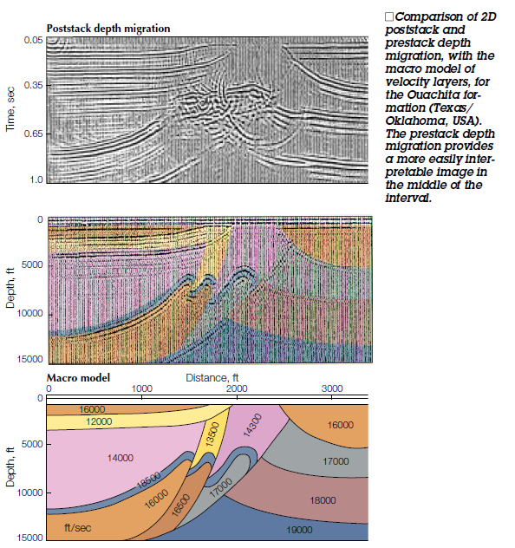
Migration
Post-stack time migration
Migration is a HUGE topic and we don’t have
Time to really go into it
BUT, you do need to know whether any data
You download has been migrated or not
Avoid working with unmigrated data- the quality
Will be very poor
Pre-stack data is better than post-stack data
If you have the option of having depth migrated
or time migrated best to go for the depth
Post-stack time migration = cheapest, poorest quality
Pre-stack depth migration = most expensive, best quality
Pre-stack time migration = most common, compromise
Pre-stack depth migration

Slide 19
Still confused? Have further questions?
Feel free to direct message me on Teams or drop me an email
(or Raul or any of the GTAs).
We are really happy to discuss things further

